Slide 1
Student Details
NAMe : Vineet saini
Skillsbuild email id : 2020jobofficial@gmail.com
Skillbuild organization : DGt
College name : Infinity management & engineering college Sagar
College state : Madhya Pradesh
Internship domain : frontend development internship
Internship start : 12 June 2023
Internship end : 24 July 2023

Slide 2
E-commerce Website
Flipkart Clone

Slide 3

AGENDA
Project preview.
Who are the end User.
Your Solution and its value proposition.
How did you customize the project and make it your own.
Modeling.
Results.
Links.
Thank you

Slide 4
PROJECT OVERVIEW
This is an e-commerce website that offers a wide range of products to customers. The user interface is designed to be simple and intuitive, allowing users to easily navigate through the site. The search functionality was not added because this is a static website here backend was not included, while the product pages provide detailed information about each item. The shopping cart feature enables users to easily add items to their cart and the button is redirect to original site.

Slide 5
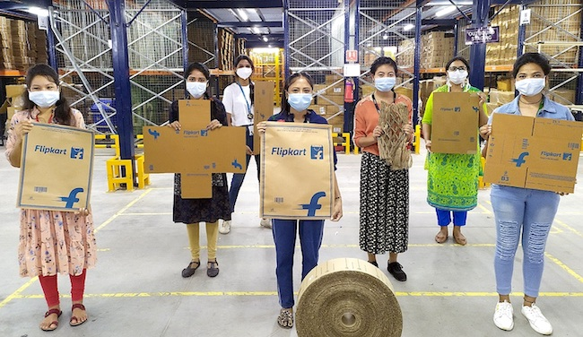
WHO ARE THE END USERS of this project?
The end user of our project is a tech-savvy individual who values convenience and efficiency. Our target audience includes people of all ages who enjoy online shopping and want to save time by quickly finding what they need. They are comfortable with technology and expect seamless integration between different platforms.
our project caters to those who want to stay up-to-date with the latest trends and products. We understand that our users have busy lives and don't always have time to browse through multiple websites. Therefore, we have designed our platform to provide a one-stop-shop for all their needs.

Slide 6
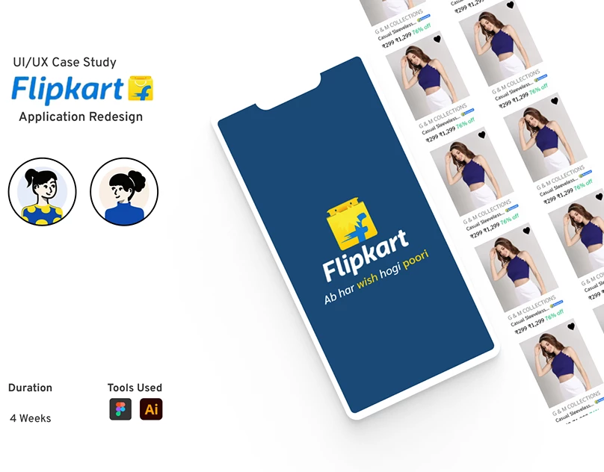
YOUR SOLUTION AND ITS VALUE PROPOSITION
Our solution provides a seamless shopping experience for our users, with an intuitive user interface that allows for easy navigation . We have also incorporated product pages that provide detailed information about each item, as well as a shopping cart that makes the checkout process quick and simple.

Slide 7
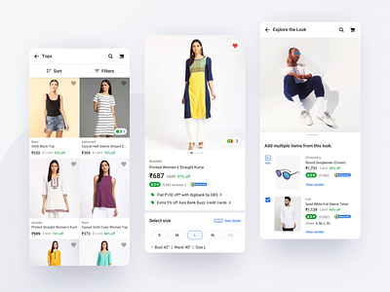
How did you customize the project and make it your own
To make my project truly unique and personalized, I took a user-centric approach to design. I have tried to customize this site and get a good looks and feel.
I also incorporated several custom features that set our project apart from others in the market. We also created a visually product page layout that showcases each item in an engaging and informative way.

Slide 8
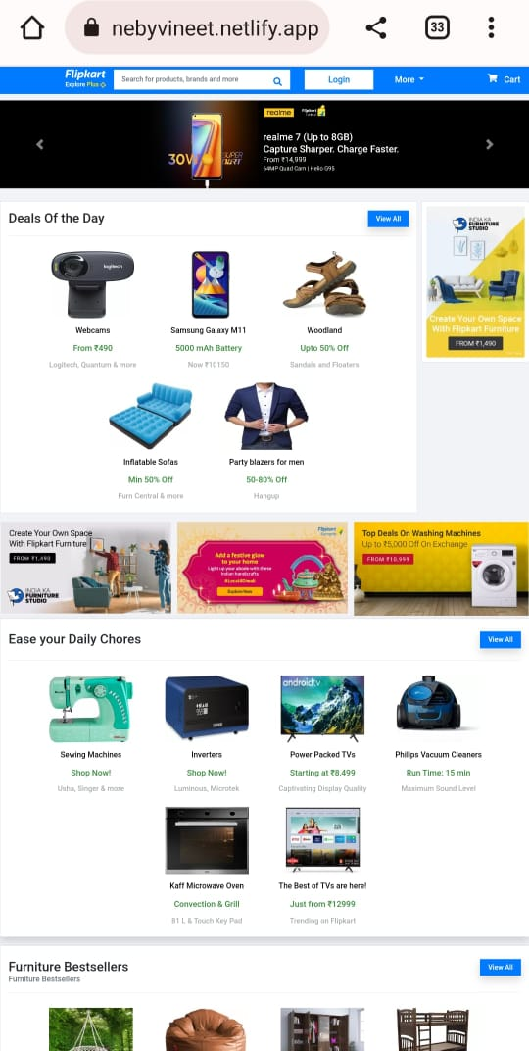
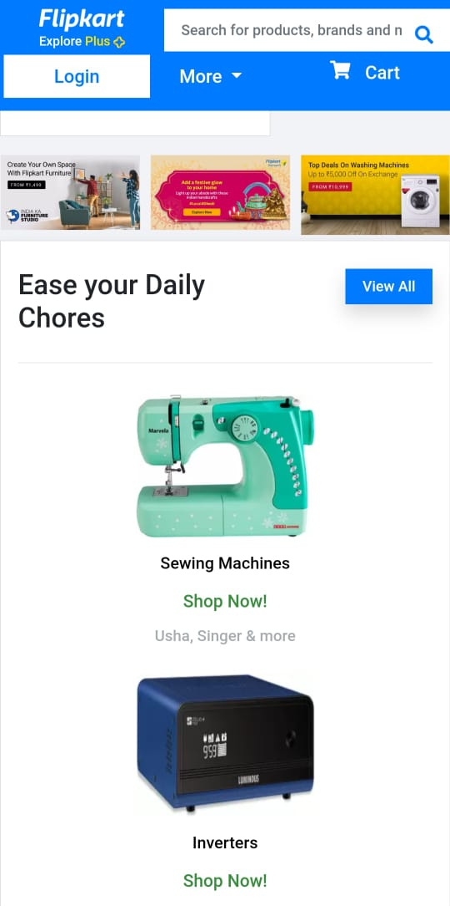
MODELLING

Slide 9
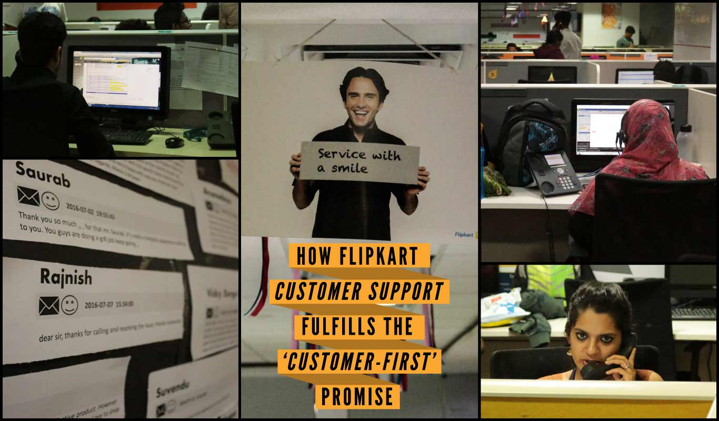
Results
Our user interface is intuitive and easy to navigate, allowing users to quickly find what they are looking for. I give my best to make a fully responsive web page and I hope you all like this . The product pages provide detailed information about each item, including multiple images and customer reviews . I was added some URL and links to my website that connect to Flipkart site. That make a very good look and feel for all the user . I will always trying to add new Functionality on it. That all my side.

Slide 10
links
Here are some useful links related to our project:
Our project repository on GitHub: - https://github.com/Vineetsaini8269/flipcart-clone
Our project's page on Netlify :- https://flipcartclonebyvineet.netlify.app/
Feel free to explore these links to learn more about our project and its development process.

Slide 11

thankyou
We would like to express our sincere gratitude to everyone who has supported us throughout this project. Your encouragement, feedback, and contributions have been invaluable in helping us create a successful product.
We are grateful for the opportunity to work on this project and for the valuable lessons we have learned along the way. We look forward to applying these skills and knowledge to future projects and continuing to grow as developers.

